Slide 2
Assessing Epi Capacity in 27 Big Cities: Results from a Recent Assessment & Implications for Practice
Jessica Arrazola, DrPH, MPH, CHES (Senior Program Analyst, CSTE)
Chrissie Juliano, MPP (Director, BCHC)
Meghan McGinty, PhD, MPH, MBA (Deputy Director, BCHC)

Slide 3
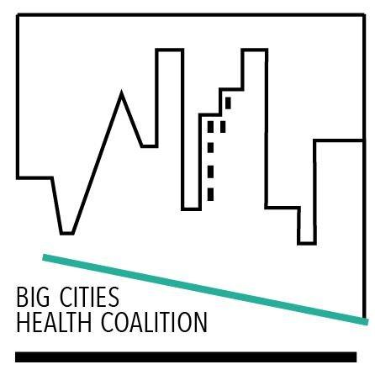
Outline of Session
Who are BCHC and CSTE?
What is the ECA?
Overview of BCHC results
Overview of state results
Interesting differences between BCHC and state
Q/A discussion

Slide 4
Acknowledgements
CSTE would like to acknowledge and thank our colleagues for their support and guidance on the project: Nancy Binkin, Beth Daly, Rich Danila, Jeff Engel, Aaron Fleischauer, Bob Harrison, Sara Huston, Mia Israel, Chrissie Juliano, Becky Lampkins, Jennifer Lemmings, Meredith Lichtenstein Cone, Amanda Masters, Joe McLaughlin, Meghan McGinty, Dhara Shah, Kathy Turner, Patty Quinlisk, Sharon Watkins, BCHC, and the NACCHO local epidemiology workgroup.
This project was supported in part by CDC cooperative agreement numbers 5U38OT000143-04 and 5U38OT000143-05. The contents are solely the responsibility of the authors and do not necessarily represent the official views of CDC.
BCHC also thanks its foundation funders and Members for enabling and supporting our participation in this work.

Slide 5
Learning Objectives
Compare innovative ways to structure local public health departments that maximize resources to enhance service delivery to the community
Describe approaches to refining and developing sub-county measures and metrics to enhance local data availability and unmask health gaps.

Slide 6
About BCHC
Founded in 2002
Operated out of NYC until 2012 when it moved to NACCHO
Mission: Advancing equity and health for present and future generations
Vision: Healthy, more equitable communities through big city innovation and leadership

Slide 7
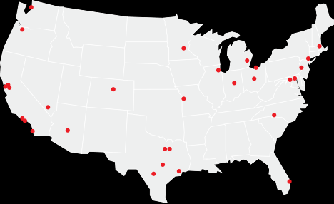
30 Member Cities
Austin
Baltimore
Boston
Charlotte (Mecklenburg Cty)
Chicago
Cleveland
Columbus
Dallas
Denver
Detroit
Fort Worth (Tarrant Cty)
Houston
Indianapolis (Marion Cty)
Kansas City
Las Vegas (S. NV Hlth District)
Los Angeles (Cty)
Long Beach
Miami (Miami-Dade Cty)
Minneapolis
New York City
Oakland (Alameda Cty)
Philadelphia
Phoenix (Maricopa Cty)
Portland (Multnomah Cty)
San Antonio
San Diego (Cty)
San Francisco
San Jose (Santa Clara Cty)
Seattle (Seattle-King Cty)
Washington, D.C.
About 55 million – or 1 in 6 – Americans covered by BCHC-member LHDs
Notes:
The Big Cities Health Coalition (BCHC) is a forum for the leaders of America’s largest metropolitan health departments to exchange strategies and jointly address issues to promote and protect the health and safety of the 55 million people they serve. Together, these public health officials directly affect the health and well-being of one in six Americans. The Coalition’s mission is to advance equity and health for present and future generations.
The Coalition is an independent project of the National Association of County and City Health Officials, which represents the nearly 3,000 health departments in the US.

Slide 8
About CSTE
Formed in 1951 to define and recommend nationally notifiable diseases and conditions for CDC
Membership association and community of practice on issues of surveillance and informatics
Over 2000 members

Slide 9
Background – Epi Capacity Assessment
CSTE has conducted ECAs in 2001, 2004, 2006, 2009, 2013, & 2017
ECA Objectives
Enumerate the epidemiology workforce at State and Territorial health departments
Describe epi capacity by subject area and Essential Public Health Services (EPHS)
Describe the funding supporting the epi workforce
Identify areas of concern among epi leadership
Notes:
The purpose of the ECA is to enumerate and describe the epi workforce at state and territorial health departments. CSTE has conducted ECAs since 2001.

Slide 10
Why State & Local?
Prior limitation is focus on state HDs, not capturing numeric and functional capacity of locals
Partnered with BCHC to assess the local epidemiology capacity in large urban health departments
CSTE and BCHC solicited input from local epis to tailor the ECA to locals

Slide 11
Definitions
Capacity: The ability to lead activities, provide subject matter expertise, and apply for, receive, and manage resources to conduct key activities
Epidemiologist:
“All those employed by the state; all those working at the state level who are either federal assignees (e.g. EISO, CEFO, PHAP) or contract employees (e.g. CSTE trainee, contracted from school of public health to work at or for the State Health Department); and state employees assigned to work at a local or regional level (e.g. to conduct investigations for a region of the state).”
“An investigator who studies the occurrence of disease or other health related conditions or events in defined populations. The control of disease in populations is often also considered to be a task for the epidemiologist.”

Slide 12
Essential Public Health Services Defined
CSTE measured capacity in four primary Essential Public Health Services (EPHS) most relevant to epidemiology:
EPHS #1 – Monitoring health status
EPHS #2 – Investigating community health problems and hazards
EPHS #9 – Evaluating the effectiveness of public health interventions
EPHS #10 – Conducting research

Slide 13
Response Rate
BCHC: 27/30 (90%) member city/county health departments
States: All (100%) 50 states and the District of Columbia responded along with 3 out of /6 Territories

Slide 14
BCHC Results

Slide 15
Structure and General Organization
48% indicated the epi workforce decentralized
37% indicated centralized w/in one division or office
15% reported the epi workforce is a hybrid structure
82% indicated the presence of on or more lead epis
78% indicated they have “generalists” supporting multiple program areas
Notes:
BCHC departments vary considerably in their structure and organization.

Slide 16
Notes:
All the BCHC departments have programs in infectious disease, MCH, and preparedness, and at least 85% have programs in chronic disease, vital statistics, and environmental health. Coverage for other program areas is lower.
100% of respondents have programs in infectious disease, maternal-child health (MCH), and preparedness. Most also have programs in chronic disease (93%), vital statistics (92%), and environmental health (85%). In contrast, fewer have programs in mental health (33%) and occupational health (19%), and none have genomics programs (0%).
Not all programs have lead epidemiologists. While BCHC departments have a wide variety of specific programs, far fewer departments have epidemiologic leads within each of program.
The number of BCHC departments with formal lead epidemiologists in a given program was consistently less than the number of departments that had that program area. For example, while 67% of departments had an injury program, only 48% had a lead epi in that program area. Those that were most likely to have a formal lead epidemiologist were infectious disease (85%), MCH (74%), and vital statistics (67%).

Slide 17
Notes:
There are a total of 1091 full time equivalent (FTE) epidemiologists working in the participating BCHC departments. The number of epidemiologists per health department ranged from 3 to 385, with a median of 18. The median rate among the 27 BCHC jurisdictions is 1.4 epidemiologists per 100,000 people, with a range of 0.4 to 7.5.
More than four in 10 (xx%) epidemiologists work in infectious diseases, and nearly one in five (18%) are general epidemiologists
The majority of health departments have general epidemiologists on staff who cover multiple areas.

Slide 18
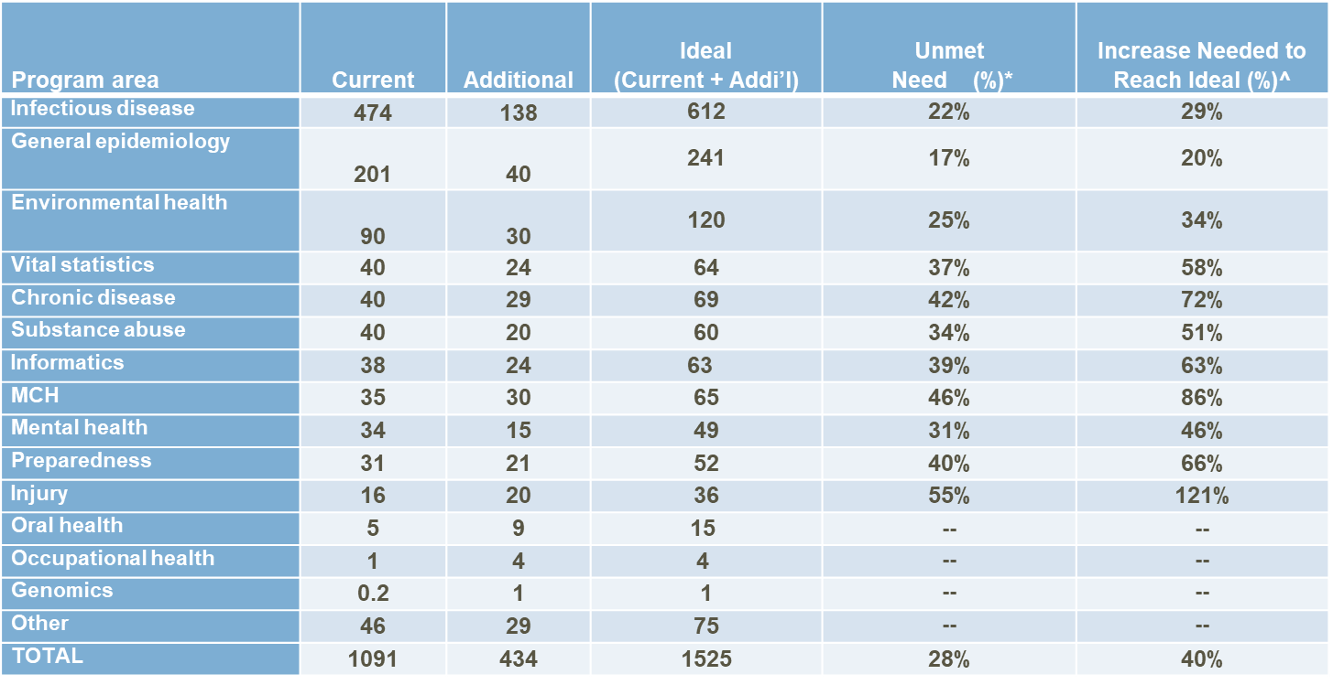
Unmet Staffing Needs
Notes:
Overall, respondents reported a need for an additional 434 epidemiologists across all the program areas. The ideal number of epidemiologists, defined as the sum of current and additional, was 1525. To reach this projected full capacity, BCHC departments would collectively need a 40% increase in epidemiologists (Table 1).
To achieve full capacity, participating BCHC departments reported that they need the greatest number of epidemiologists in infectious disease (n=138), followed by general (n=40), MCH and environmental health (n=30 each), and chronic disease (n=29) (Table 1). Among program areas currently with more than five epidemiologists, the greatest percentage increase needed to achieve ideal levels of staffing are in injury (121%) and MCH (86%).
* Additional/ideal *100; Percent unmet need is calculated only for program areas with >5 FTE epidemiologists
^(Additional/ current *100; Percent increase in FTEs needed to reach ideal is calculated only for program areas with >5 FTE epidemiologists

Slide 19
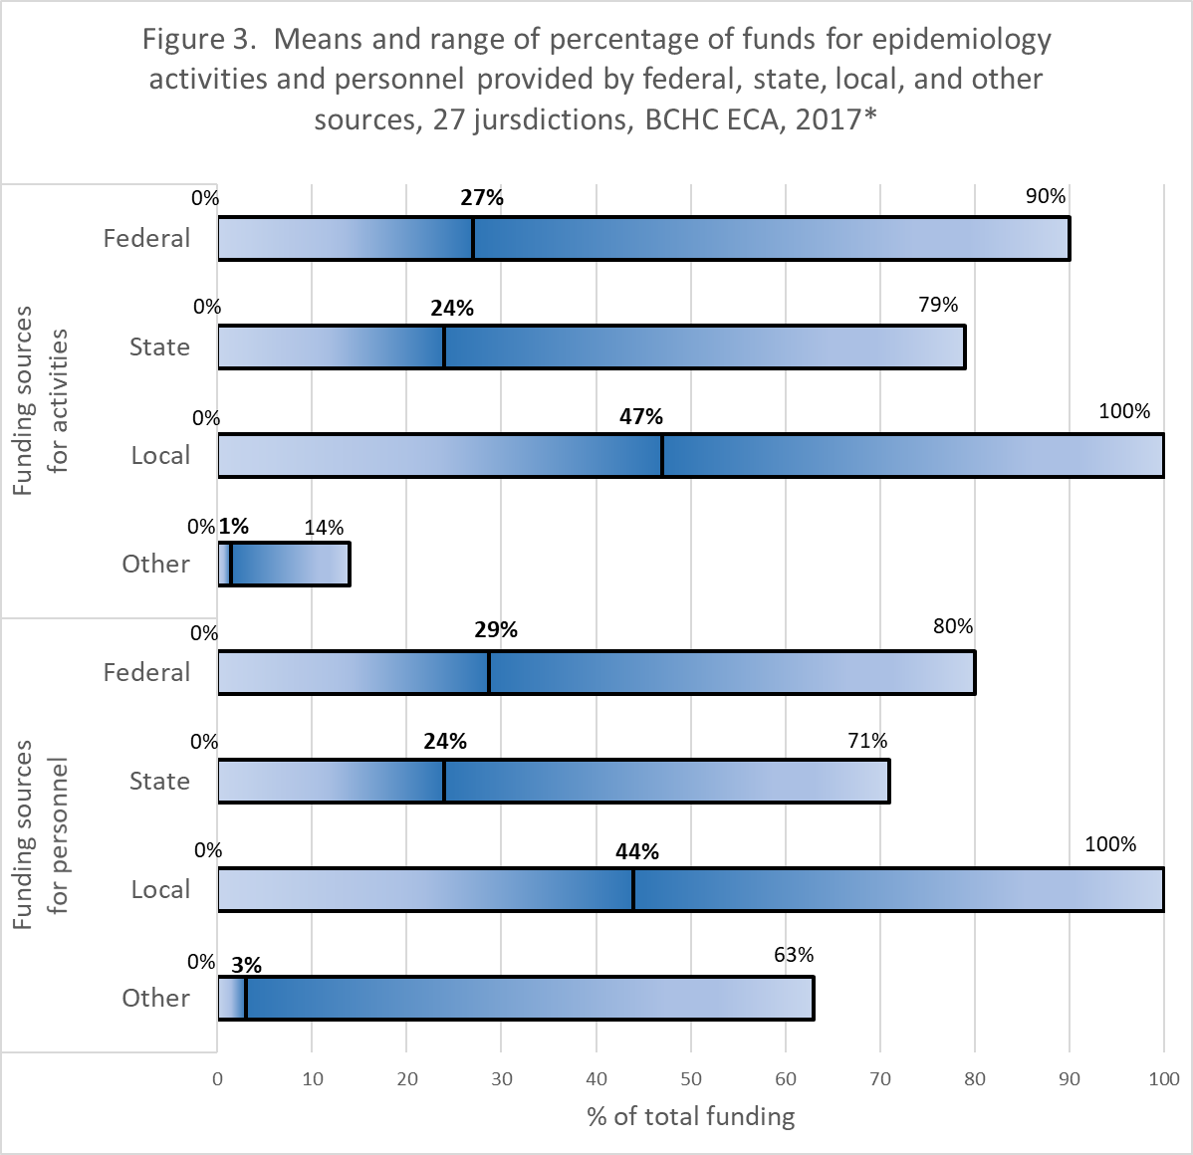
Notes:
On average 47% of the funds for epidemiology activities were from local sources, with state and the federal governments providing an additional 24% and 27%, respectively. Values were similar for epidemiology personnel, with 44% of funding coming from local sources, 24% from state sources, and 29% from federal sources. Other non-governmental funding sources such as private foundation or non-profit grants, donations or corporate sponsorships represented on average 1% of funding for epidemiologic activities and 3% of personnel for epidemiology staff in BCHC departments.

Slide 20
Notes:
EPHS capacity is high for monitoring health status to identify and solve community health problems and to diagnose and investigate health problems and health hazards in the community but is much lower for evaluating effectiveness, acceptability, and quality of health services and researching new insights and innovative solutions to health problems. These findings suggest that health agencies may wish to focus more on hiring epidemiologists with evaluation and research skills, providing existing staff with evaluation and research training, and diversifying funding to support evaluation and research activities.

Slide 21
Notes:
* Capacity was defined as having the ability to lead epidemiologic activities, provide subject matter expertise, and apply for, receive, and manage resources to conduct key epidemiologic activities.
The perceived need for enhanced EPHS capacity exceeded 70% in nearly all program areas, including those that appear to be well staffed. Perceived need was highest for chronic disease, infectious disease, environmental health, injury, and substance abuse. Three of these areas, chronic disease, infectious disease, and substance abuse were the most frequently designated as highest priority for improvement. Respondents’ perceived need for expanded capacity, even in infectious disease, suggests that the current workforce may lack the skillsets needed to achieve adequate EPHS capacity.

Slide 22
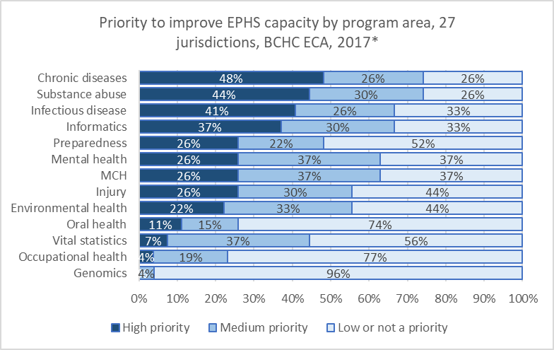
Notes:
The program areas most frequently identified as a high priority for improving capacity were chronic disease (48%), substance abuse (44%), infectious disease (41%) and informatics (37%) (Figure 7).

Slide 23
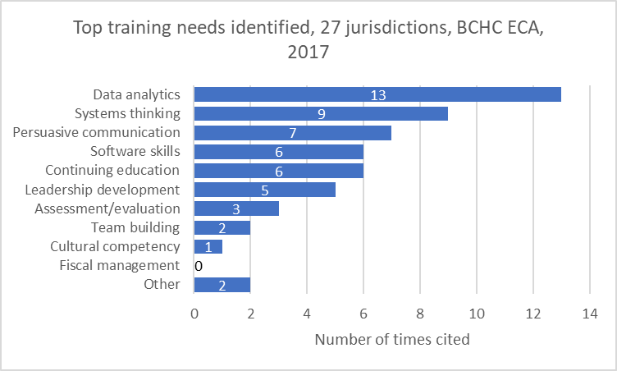
Notes:
Each participating BCHC department selected their top two most pressing staff needs from a list of 11 broad training areas (for a total possible n of 54). As seen in Figure 10, the highest priority, by a considerable margin, was data analytics (e.g., informatics, translating and applying public health data). Other training priorities included: systems thinking (systems development, change management, strategic planning, and/or flexibility), and persuasive communication (articulating a message to the public, communicating public health research and data, policy engagement, etc.), software skills (Epi Info, SAS, SPSS, R, etc.) and general continuing education (basic epi refreshers, novel methodologies, updates to the field/literature, etc.).
By a considerable margin, the greatest training priority was in analytics, defined as informatics and the application and translation of public health data. Other training priorities included systems thinking, and persuasive communication. Partnerships and collaboration with schools and programs of public health to incorporate analytics into their curricula could contribute to developing these much-needed skills in the applied epidemiology workforce.

Slide 24
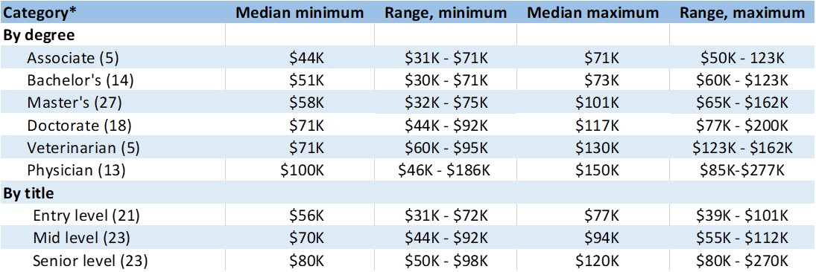
BCHC Salary Ranges by Degree and Title
Notes:
*Values in parentheses represent number of respondents

Slide 25
State Results

Slide 26
Staffing levels are Inadequate
“[There is a] lack of funding and state positions to expand capacity in areas with existing epidemiologic activities and to create capacity in areas without current epidemiologic activities.”
“[A challenge is] balancing resources to meet emerging issues, basic responsibilities and cooperative agreement deliverables”
“We are challenged with continued increasing reporting and work requirements in most program areas despite level or decreasing federal funding.”
Notes:
Overall, current staffing levels are inadequate to meet the needs to maintain basic epidemiological functions and emerging problems.

Slide 27
Epis Enumerated
Notes:
In 2017, US state health departments employed 3,370 epidemiologists, compared with 2,752 in 2013—a 22% increase (Table 1). The number of epidemiologists per state ranged from 5 to 208. And the overall number per 100,000 population was 1.04, 20% higher than in 2013, when the ECA documented 0.87 epidemiologists/100,000.

Slide 28
Ideal Number of Epis
*current/ideal *100
‡ (ideal-current)/current *100
Notes:
Overall, the ideal number of epidemiologists was 4,568, constituting a 36% increase over the current number of epidemiologists (Table 2). Current staffing levels represent 74% of desired capacity.
The greatest additional number of epidemiologists to achieve ideal capacity was in infectious diseases (338), followed by chronic diseases (137), MCH (122), and environmental health (122). Percentage-wise, however, mental health needed a 1,058% increase, from 4 to 46 epidemiologists, followed by genomics (459% increase needed), oral health (139%) and occupational health (134%).

Slide 29
Trends in Epis
Notes:
The number of infectious disease epidemiologists continues to increase dramatically, while preparedness positions declined abruptly in 2017.

Slide 30
Specific skillsets are needed
“One of my main concerns is having a workforce prepared to function in the new world of public health epidemiology. We are facing big changes right now in how we receive information, the volume of data/information, emerging programs related to [hospital acquired infections] with large expectations [and] rapid changes in lab testing…. that affect the information we receive and the need to adapt all our investigation protocols accordingly. It is challenging to keep the workforce well prepared in the face of so much change at such a rapid pace.”
“Transitioning from a number of one-off data systems to a more efficient interoperable system with enterprise-wide approaches to data collection, data parsing, data provisioning, data preparing, data analysis and data visualization requires additional training in informatics and data analytics.”
“There is a need for epidemiologists to be able to think critically about the diseases and risk factors under surveillance and to be able to look beyond the mechanics of just data analysis.”
Notes:
New or different knowledge and skillsets are needed to meet to current gaps in capacity, to respond to emerging public health challenges, and to adapt to new technologies.
The need to improve skills in evaluation, communication with the public, and risk communication were frequently cited by respondents. They also frequently identified emerging fields of informatics and data analytics as high priority for training. At the same time, however, respondents stressed the importance of maintaining traditional epidemiological skillsets and developing the ability to step back and look at the bigger picture.

Slide 31
EPHS Capacity
Notes:
When I mention EPHS capacity, we focus one 4 key services most relevant to epidemiologists including: monitoring health status, diagnosing and investigating health problems, evaluation, and research.
States report substantial or better capacity in monitoring health status and diagnosing and investigating health problems, but more limited capacity in evaluation and research.
State health department research capacity fell between 2013 and 2017, while capacity for the other three EPHS rose slightly.

Slide 32
EPHS Capacity by Program Area
Notes:
Capacity is high in well-established program areas including infectious diseases, MCH, and chronic diseases but is lower for newer areas such as genomics and informatics and for areas with low and waning numbers of epidemiologists, such as oral health and environmental health.

Slide 33
Need to Improve EPHS
Notes:
The program areas reported to have greatest need for improved capacity to carry out the four epidemiology-dependent EPHS (#1, 2, 9, 10) are mental health (94% of state respondents citing a need), substance abuse (93%), informatics (93%) and injury (90%) (Figure 13). There was a strong statistical association (p ≤ 0.02) between perceived capacity and need to improve for all areas except oral health, mental health, and informatics.

Slide 34
Priority to Improve EPHS
Notes:
Perceived need for improvement was highest for mental health, substance abuse, and informatics. State Epidemiologists most frequently cite substance abuse and informatics programs as a “high priority” for improvement.

Slide 35
Training Priorities
Notes:
Data analytics is a top training need for the majority of states.
Respondents were asked to identify their two top training needs. As seen in Figure 17, the most frequently identified training priority, by a considerable margin, is data analytics, defined as informatics and applying and translating public health data (cited as a top training need by 38 respondents). Other training priorities included systems thinking (systems development, change management, strategic planning, and/or flexibility), persuasive communication (articulating a message to the public, communicating public health research and data, policy engagement, etc.) and leadership development (identifying future leaders, coaching/mentoring programs, retention of current leaders), each of which was mentioned by 12 respondents, followed by continuing education (11 respondents). Less frequently cited training needs include software skills, assessment/evaluation, fiscal management, team building, and cultural competency.

Slide 36
Uncertain funding affects staffing
“We have shrinking resources as our department becomes larger, yet we are expected to fill roles that we are not funded for.”
“Increased attention and funding to specific program areas [is] followed by loss of attention and funding, but these threats have not resulted in acknowledgment of the need to maintain a basic level of readiness for all existing and emerging threats.”
“The high level of dependency on federal funding sources limits the flexibility of the state to respond to emerging public health threats and increases vulnerability of the workforce to reductions in federal appropriations.”
Notes:
Uncertain funding for applied epidemiology harms staff morale/retention and public health preparedness.
Respondents reported that heavy reliance on federal funding in an uncertain fiscal environment has a negative impact on perceived job security, job satisfaction, staff morale and staff retention, especially in jurisdictions that are also experiencing their own budget deficits. By straining the capacity of existing staff, unfunded—or inconsistently funded—mandates undercut readiness to respond to new threats. Additionally, the public health laboratories that supply critical data to epidemiologists are also experiencing budget problems.

Slide 37
Funding Trends (Activities)
Notes:
Federal funding for state epidemiology programs increased dramatically between 2001 and 2004, with an influx of preparedness funding after 9/11 and gradual funding increases between 2004 and 2013 (Figure 9). In 2017, there was a slight drop in federal funding for the first time, from 79% to 77%. As federal funds increased over time, the state contribution declined by nearly half, from a peak of 37% in 2001 to 19% in both 2013 and 2017. Although funding from other sources increased in 2017, it still represents less than 5% of total state epidemiology funds.

Slide 38
Funding by Positions
Notes:
In most program areas, the federal government, especially CDC, continues to support three out of every four epidemiology positions.
* Numbers in parentheses represent total positions nationally in each program area.
‡Occupational health, mental health, oral health, and genomics are excluded from the figure, as
they have fewer than 25 positions, nationally.

Slide 39
BCHC Vs States: Epis/100,000 people
BCHC Median: 1.4 epis per 100,000 people
Range of 0.4 to 7.5
State Median: 1.0 epis per 100,000 people
Notes:
There are a total of 1091 full time equivalent (FTE) epidemiologists working in the participating BCHC departments. The number of epidemiologists per health department ranged from 3 to 385, with a median of 18. The median rate among the 27 BCHC jurisdictions is 1.4 epidemiologists per 100,000 people, with a range of 0.4 to 7.5. In comparison, the total number of epidemiologists in state health departments is 3370, and the median rate is 1.0/100,000.

Slide 40
BCHC Vs States: Funding
47% of BCHC epi activities are from local sources
State: 24%
Federal: 27%
More than three-quarters of state epi activities are from federal sources
State: 20%
Notes:
On average 47% of the funds for epidemiology activities were from local sources, with state and the federal governments providing an additional 24% and 27%, respectively. Values were similar for epidemiology personnel, with 44% of funding coming from local sources, 24% from state sources, and 29% from federal sources. These findings are in sharp contrast to state health departments, where, on average, more than two-thirds of funds are provided by the federal government and about 20% by state governments. Other non-governmental funding sources such as private foundation or non-profit grants, donations or corporate sponsorships represented on average 1% of funding for epidemiologic activities and 3% of personnel for epidemiology staff in BCHC departments.

Slide 41
BCHC vs. States: Top Training Needs
BCHC
Data Analytics (48%)
Systems Thinking (33%)
Persuasive Communication (26%)
States
Data Analytics (38%)
Systems Thinking (12%)
Persuasive Communication (12%)
Leadership Development (12%)
Notes:
On average 47% of the funds for epidemiology activities were from local sources, with state and the federal governments providing an additional 24% and 27%, respectively. Values were similar for epidemiology personnel, with 44% of funding coming from local sources, 24% from state sources, and 29% from federal sources. These findings are in sharp contrast to state health departments, where, on average, more than two-thirds of funds are provided by the federal government and about 20% by state governments. Other non-governmental funding sources such as private foundation or non-profit grants, donations or corporate sponsorships represented on average 1% of funding for epidemiologic activities and 3% of personnel for epidemiology staff in BCHC departments.

Slide 42
BCHC vs. States: Current Program Capacity, Perceived Need to Improve Capacity, Priority to Improve Capacity
BCHC
Adequate Current Program Capacity
ID 100%, MCH 93%, CD 89%, Injury 89%
Need to Improve Capacity
CD 93%, ID 89%, EH 89%, MH 89%, Injury 88%
High/Medium Priority to Improve Capacity
CD 74%, SA 74%, ID 67%, Infx 67%
States
Substantial to Full Current Program Capacity
ID 96%, CD 78%, MCH 73%, Prep 57%
Need to Improve Capacity
MH 94%, SA 93%, Infx 93%, Injury 90%
High/Medium Priority to Improve Capacity
SA 94%, Infx 79%, MH 78%, CD 78%, ID 74%
Notes:
On average 47% of the funds for epidemiology activities were from local sources, with state and the federal governments providing an additional 24% and 27%, respectively. Values were similar for epidemiology personnel, with 44% of funding coming from local sources, 24% from state sources, and 29% from federal sources. These findings are in sharp contrast to state health departments, where, on average, more than two-thirds of funds are provided by the federal government and about 20% by state governments. Other non-governmental funding sources such as private foundation or non-profit grants, donations or corporate sponsorships represented on average 1% of funding for epidemiologic activities and 3% of personnel for epidemiology staff in BCHC departments.

Slide 43
So What Did We Learn?
Lack of predictable, sustainable funding hinders capacity building
Role of epis not well understood
Have epis for 20th century, not necessarily 21st century, PH challenges
Technology/new tech remains a challenge

Slide 44
Q/A & Audience Discussion

Slide 45
Contact Information
Chrissie Juliano (cjuliano@naccho.org)
Meghan McGinty (mmcginty@naccho.org)
Big Cities Health Coalition
www.bigcitieshealth.org
@BigCitiesHealth
https://www.facebook.com/BigCitiesHealth
http://www.bigcitieshealth.org/front-lines-blog/
Jessica Arrazola (jarrazola@cste.org)
Council of State and Territorial Epidemiologists
https://www.cste.org/
@CSTEnews
https://www.facebook.com/CSTE.org/

Slide 46
Additional Sessions
Wednesday July 11, 2018
11:30 AM – 12:00 PM | Big Cities Health Inventory: Local Data for Action (A)
1:30 PM – 2:00 PM | Big Cities Health Inventory: Local Data for Action (B)
2:15 PM – 3:45 PM | The First Nat’l Data on the LHD Workforce: PH WINS 2017
2:15 PM – 3:45 PM | More Bang for Your Buck: Learning Collaborative Partnerships Focused on Using Cost-Effectiveness Analysis in Decision Making

